Slide 1
Metra COPS
Incident Reporting for Transit Agencies
Early-Warning to help to resolve problems faster
Notes:
Roll call for both sides

Slide 2
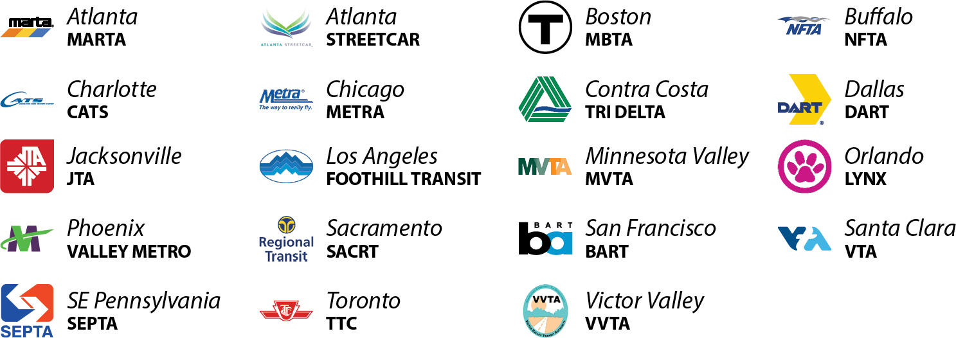
#1 See Something, Say Something … for Transit Agencies …
23 Transit Agencies use ELERTS
100% Transit Agency Customer Retention

Slide 3

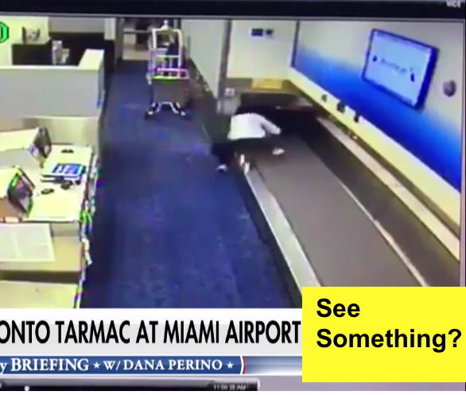
See Something (easy to do) Say Something (challenging!)
People need more than “Call 911” or “Tell a LEO”
ANYONE can “Say Something” in 20 Seconds with ELERTS app.

Slide 4

Riders feel Safer with ELERTS See Say app

Slide 5
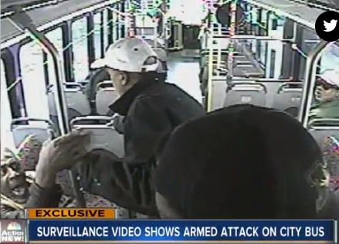
Riders who feel Unsafe become Ex-Riders
Ridership down ~20% since 2013 (LA Metro)
29% stopped riding because they felt unsafe or uncomfortable on buses and trains.
Source: LA Times

Slide 6
Multiple ways to Report
Text-A-Tip (with Photo)
Web-Form (from Browser)
Mobile App (iPhone or Android)
Call Police (with GPS info)

Slide 7
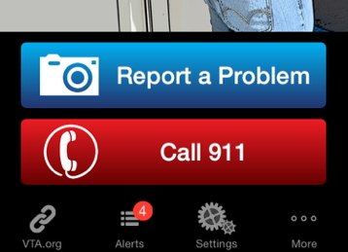
Simple UI – Two Big Buttons
Agency specifies Button text and Phone #
Multiple jurisdictions?
Use “Call 911”

Slide 8
Real Results
Incidents reported with ELERTS See Say app:
Abandoned bags
Harassment/Abuse/Assault
Vandalism
Suspicious behavior
People in tunnels/Restricted Areas
Train with wobbling wheels – possible derailment.
Robbery – handbag and bicycle theft
Bus driver being assaulted
Maintenance/Trash
Drugs being used and sold
Sighting of a murder suspect
Medical emergencies
Passed out/asleep persons
Drunk and disorderly behavior
Guns being sold on train

Slide 9
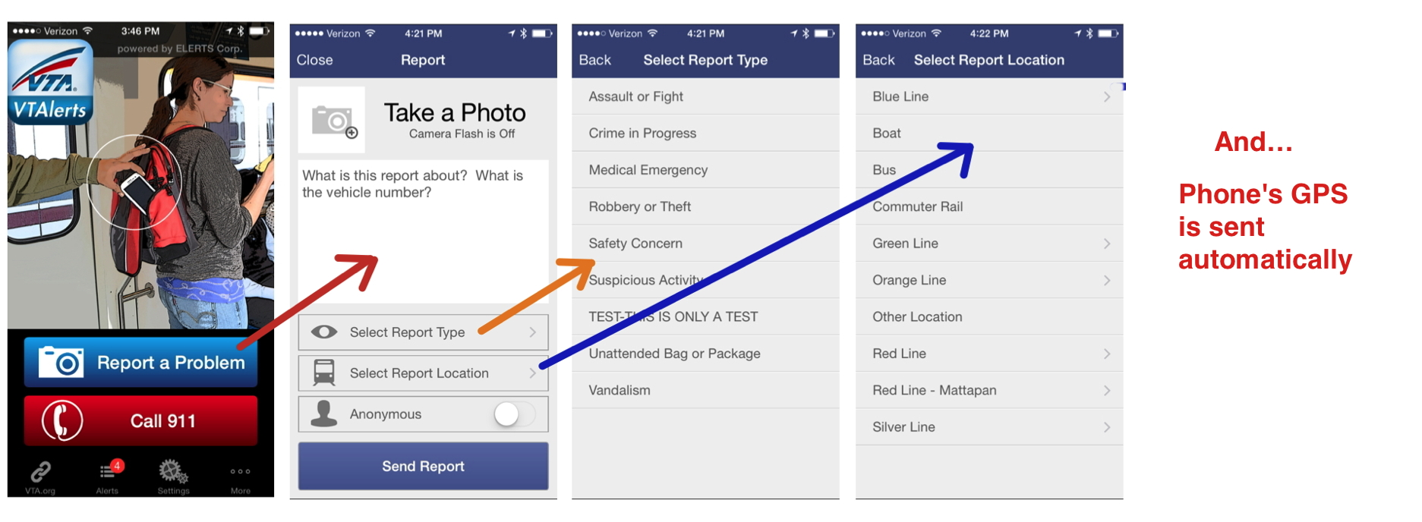


ELERTS See Say app screens
(Customized List)
Choose Rider’s Location
Camera Flash
OFF automatically
Photo, Incident Description, Report Type, Report Location, Anonymous

Slide 10
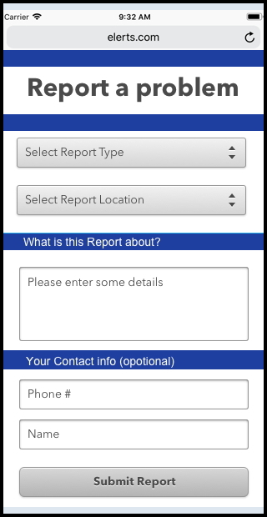
Text-A-Tip and Web-Form
ELERTS communication platform includes “Text-A-Tip” phone number, for people who prefer to use texting instead of app.
SMS Reports appear in ELERTS Console. Operator can immediately reply to Text-A-Tip reports.
Web-form also provided to enter reports from Transit’s web site.

Slide 11
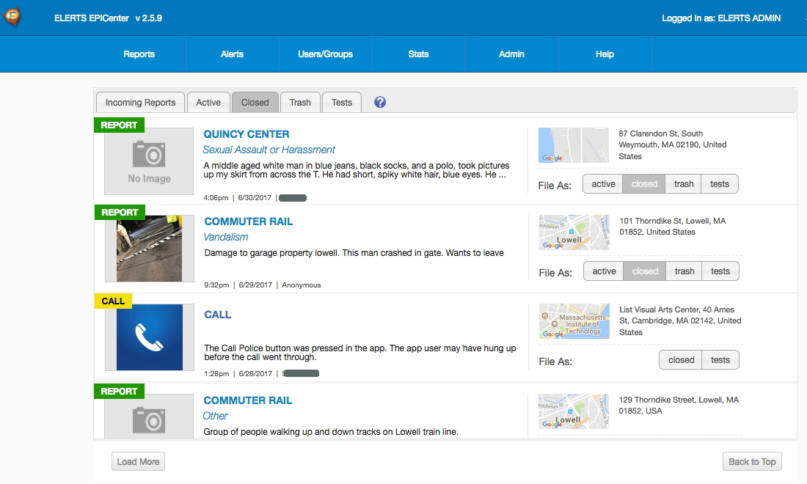
ELERTS Console
Manage reports from riders
Provides Situation Awareness:
Report Type,
Incident Description,
Photo, Video &
GPS Location.
Click Report for Detail view.
Ask Rider for more details.
No hardware required.
Cloud-based console, access by web browser.

Slide 12
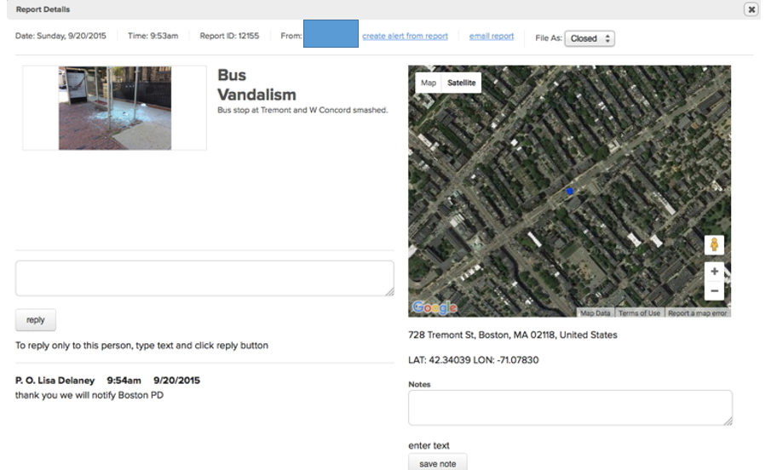
REPORT DETAILS – Dispatcher View

Slide 13
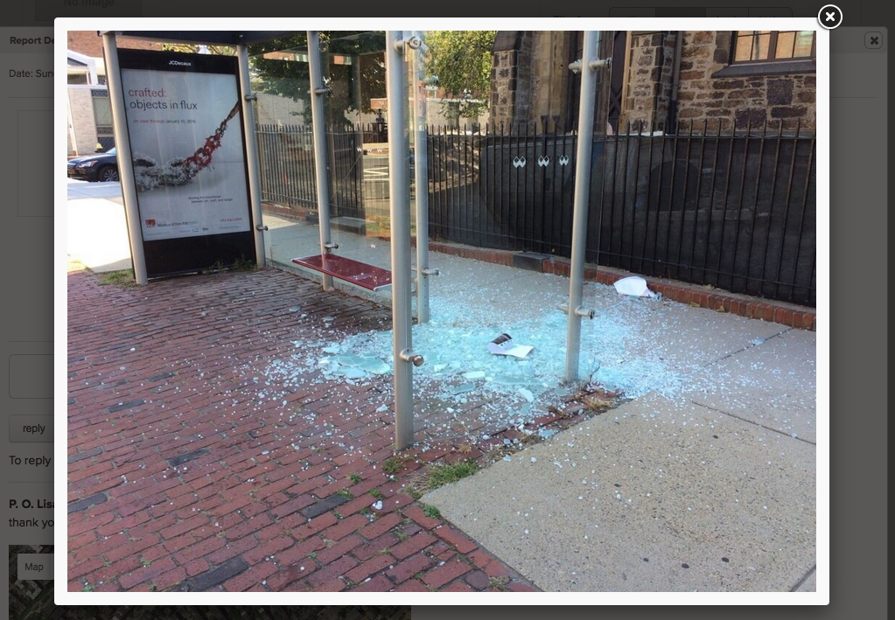
Dispatcher View – Supersize Photo

Slide 14
Use Cases for ELERTS See Say
1) Safety/Security
2) Human Trafficking
3. Maintenance/Operations

Slide 15
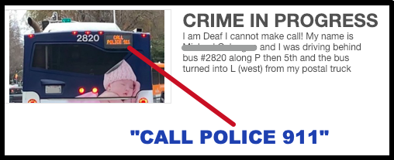
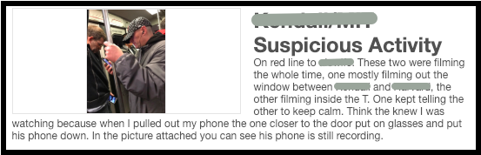
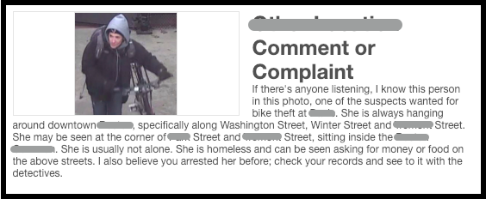
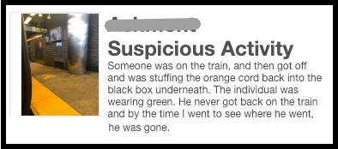
Safety / Security Examples

Slide 16
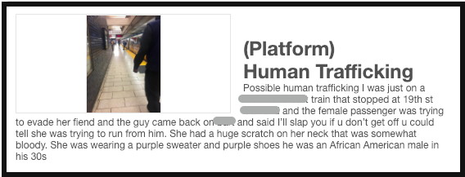
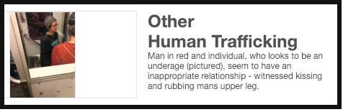
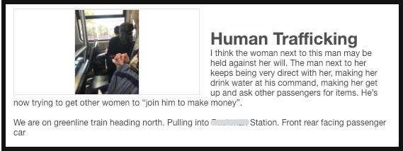
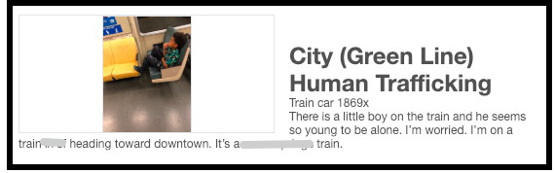
Human Trafficking examples

Slide 17
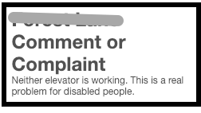
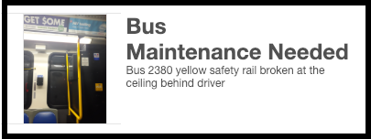
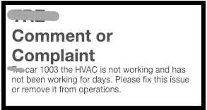
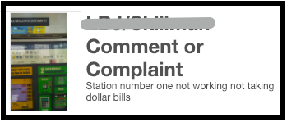
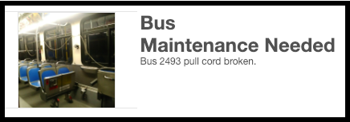
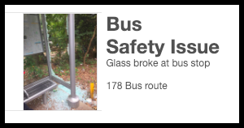
Maintenance/Operations Examples

Slide 18
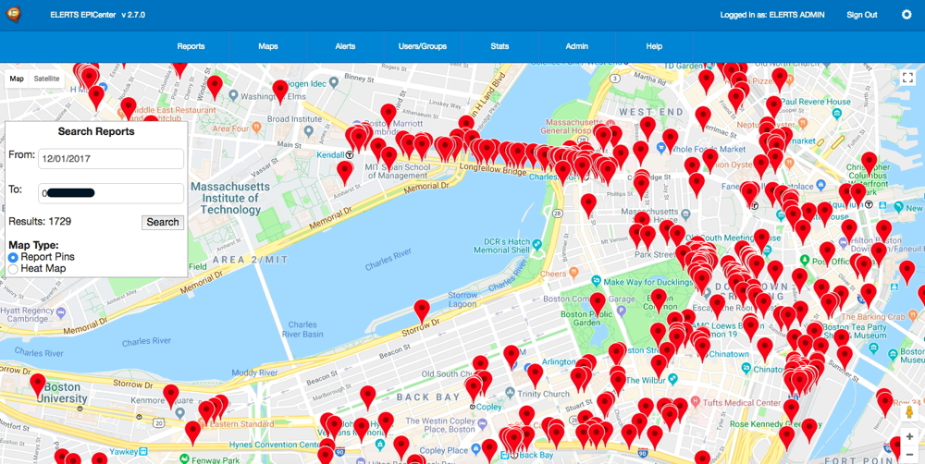
Incident Maps - Visualize where problems occur over time.
This information can help leadership to decide where to deploy security resources.
Hover over
Pin to see
Details of
An Incident
Report

Slide 19


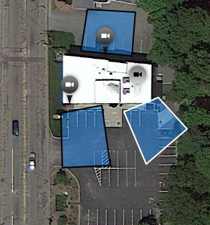

A “CRIME SEEN”
NEW – 20,000 DOT cameras included.
E.G.
ELERTS patented technology
Identifies nearby Surveillance Cameras
ELERTS Attention Engine employs or practices certain features and/or methods of U.S. Patent No. 9,607,501.

Slide 20
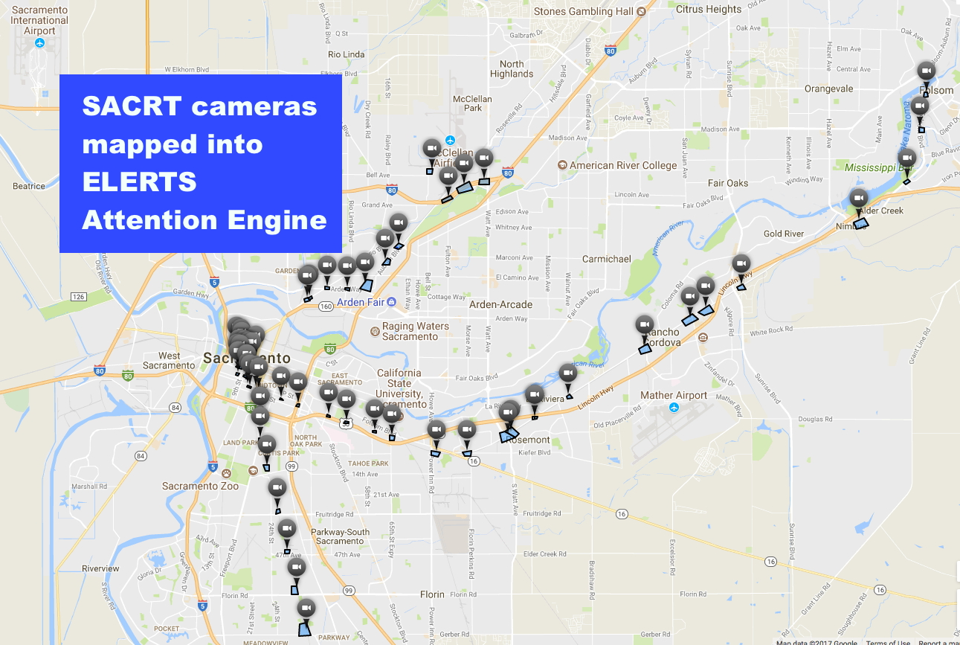

Slide 21
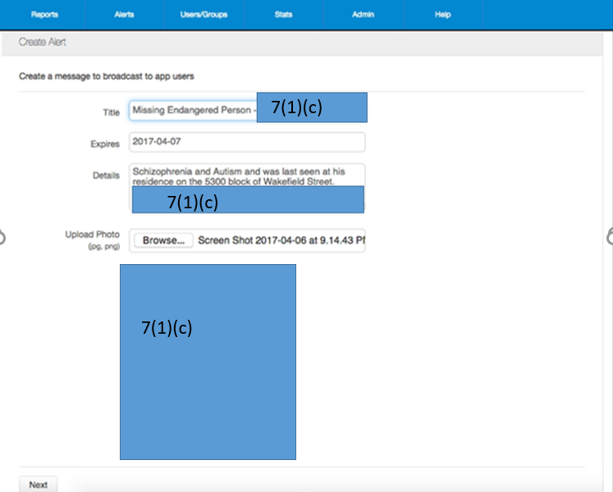
BOLO
Outbound Messaging
From console:
ALERTS may be broadcast to All users or Groups
Communication builds rapport with app users.

Slide 22
Thank you Metra for choosing
ELERTS Incident Reporting Platform
Ride safe!

